Slide 1
What is Meth?

Slide 2
Methamphetamine
Meth is the short name for the illegal drug Methamphetamine
Methamphetamine is an illegal drug that causes the brain to feel fake happiness by releasing a chemical called DOPAMINE
Meth goes by other names too including:
Crystal, Ice, Glass, Speed, and many other “street names”
Meth looks like clear crystal chunks or blue/white rocks

Slide 3
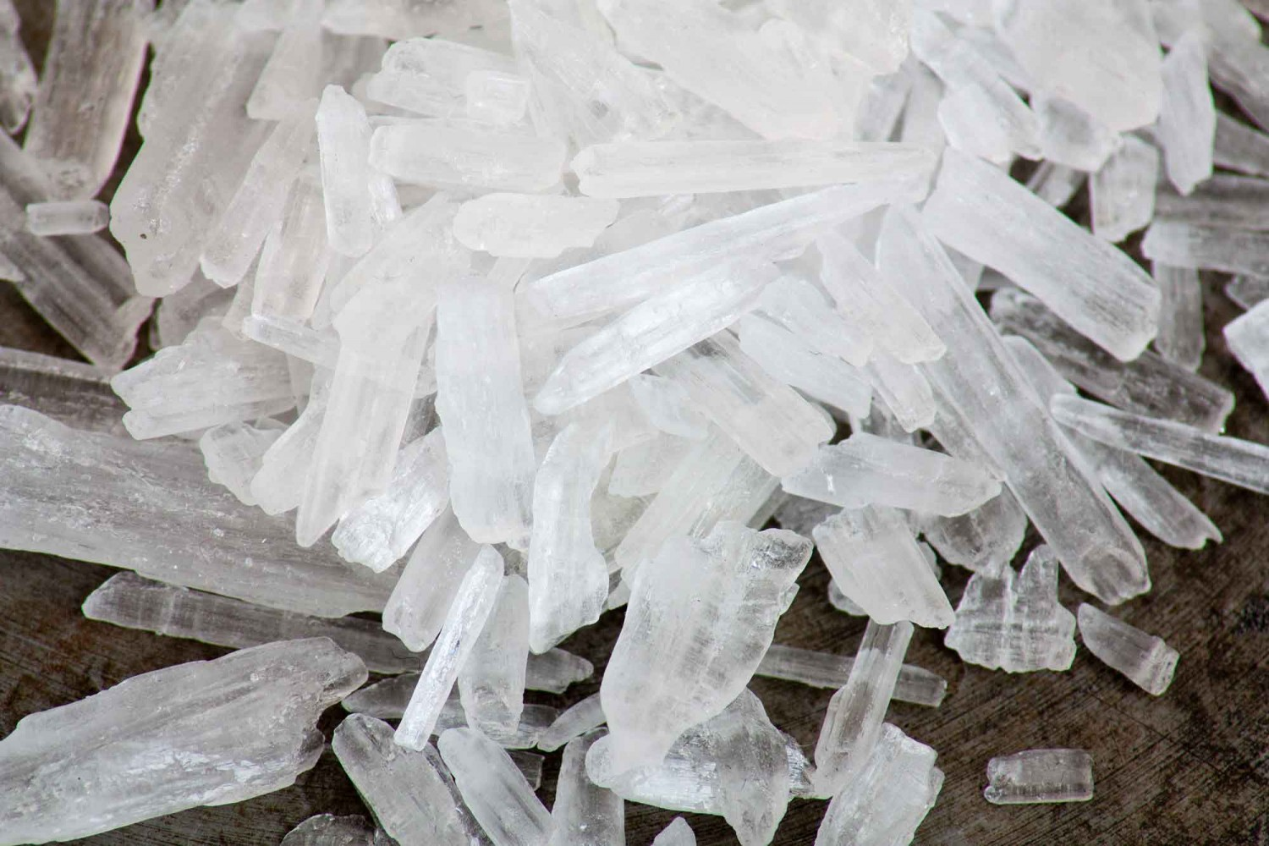
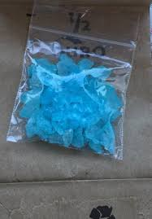
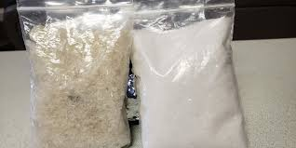
What can Meth Look Like?
Meth Rocks
Meth Powder
Meth Crystals

Slide 4

Short Term Effects of Meth
Meth can make you feel:
Like you are happy when you really are not
Like you have a lot of energy even if you do not
Like you can do anything even if it is dangerous

Slide 5

When You Use Meth…..
Your blood pressure goes up
Your body temperature goes up
You can feel nervous or sad
Your emotions go up and down
You don’t think like you normally do
You don’t act like you normally do

Slide 6

The Effects of Meth Can Last Up To
12
Hours

Slide 7
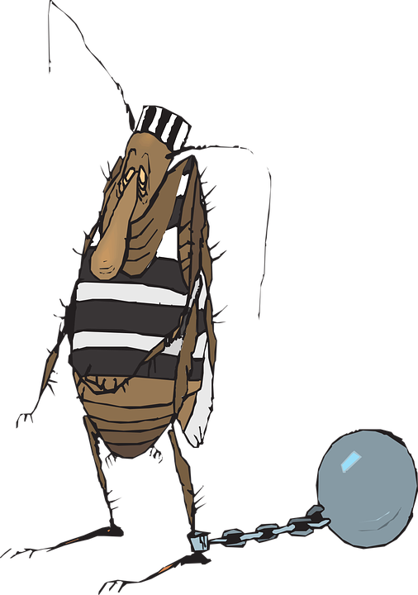
Meth is Addictive
When people start using meth, they usually have a hard time stopping - this is called ADDICTION
Some people become addicted to meth after just one use!

Slide 8
So…..When Is It Safe To Try Meth??
NOT
EVEN
ONCE

Slide 9
Why Would Anyone Use Meth?
Meth causes the chemical Dopamine to be released in your brain
Dopamine makes you think you are happy even when you are not
Some people use meth because they want to feel happy
Can you think of other ways to feel happy?

Slide 10
Discussion Questions
Why might a person want to try meth?
How might a person hope to feel when they use meth?
How do you think a person might really feel if they use meth?
What other things can a person do to feel happy instead of doing meth?

