Slide 1

How the Brain Feels
HAPPY…...
and the Way Meth Lies

Slide 2




The Four Happiness Chemicals
The brain releases four chemicals to feel happy:
OXYTOCIN
SEROTONIN
ENDORPHINS
DOPAMINE
Notes:
Oxytocin is connected to feelings of love
Serotonin is connected to overall happiness and a sense of well-being
Endorphins help with pain during sports or exercise
Dopamine helps you want to do and learn more

Slide 3
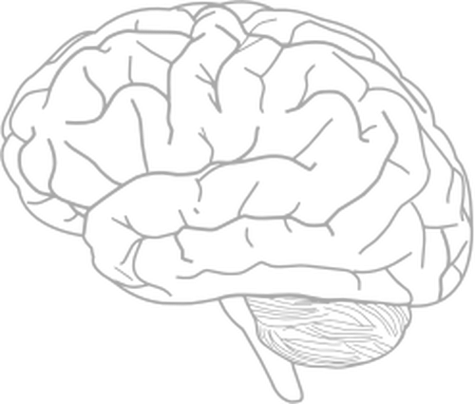
Meth Lies to the Brain
Meth makes a person think they are happy even when they are not by causing extra Dopamine to be released in the brain

Slide 4
Meth Takes Away Happiness
Overtime, Meth destroys the brain's ability to use Dopamine
The more Meth a person uses, the less happiness they feel
Eventually, people who use Meth struggle to feel any happiness at all EVEN WHEN DOING THE THINGS THAT MADE THEM HAPPY BEFORE!
People who use Meth can repair the Dopamine in their brains by quitting using the drug - but it takes a long time to start to feel happiness again.

Slide 5




There are Better Ways to Create Dopamine
What are some ways you can think of to create Dopamine in your brain?

Slide 6
Discussion
How would you feel if the activities that make you happy now stopped making you happy?
What activities do you do that you would NEVER risk losing happiness with?

